Slide 1
Intro & Refreshers

Slide 2
What’s Expected From You
Attend Lectures
  If you don’t, you will miss out on things that you will need to know
  Reading the slides is not enough
Be active and think critically
  Ask questions. Come to office hours if you need to. Send email.
Do projects and homework
  Start early and be honest
Study for tests
Respect the class and each other
  Devices for notes only

Slide 3
Computer Architect
Look backward (what has already been done)
  Understand design decisions and tradeoffs. Remember – people in the past were just as smart as you.
Look forward (what is coming)
  Push the state of the art. Consider new materials, new ideas and manufacturing processes as well as new needs.
Look up (at the rest of the computing infrastructure)
  New languages, software engineering principles change requirements
Look down (towards circuits)
  What’s new in circuit design that changes what we can do?

Slide 4
This Course
Users
Operating System
Computer Organization
Applications
VMs (like JVM)
Computer Architecture
Electricity and Sand
Digital Design

Slide 5
Abstractions
We go through our lives knowing but not thinking actively about many things.
When I drive, I don’t consider what I know about the internal combustion engine. When I cook, I don’t consider the chemical changes inside my food.
Even though I know something about it, I don’t actively consider it.
Abstractions reduce my cognitive load.

Slide 6
Then why learn?
What if something goes wrong?
My program is too slow
My program isn’t returning the results I expect
I need a computer that uses less power
My operating system is compromised

Slide 7
Goals:
Learn how processors and computer work, from the electricity and sand level to (just below) the operating system level
Solidify our assembly language knowledge
Understand and make design tradeoffs
Be able to make more knowledgeable recommendations on computer hardware and systems

Slide 8
Von Neumann Model
Also known as the stored program model
  Instructions stored in memory one after another
  Memory is unified – one memory for program and data
  Except for control instructions, instructions are sequential

Slide 9
How do we represent numbers in a computer?
Computers have no implicit understanding of numbers, math, letters, words or, really, anything.
What they CAN do is follow certain rules/operations that are built in.
In order for this to be useful, we all have to agree on some basic principles.

Slide 10
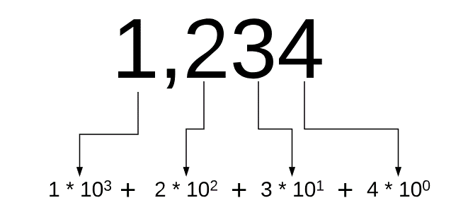
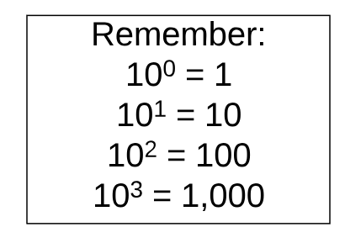
Integers in base 10

Slide 11
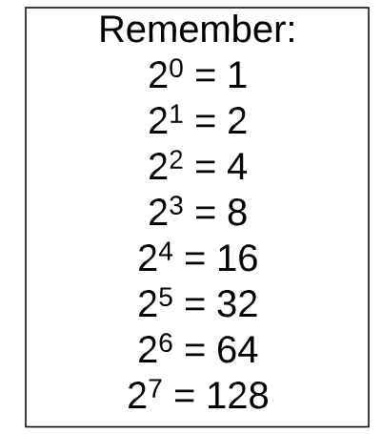
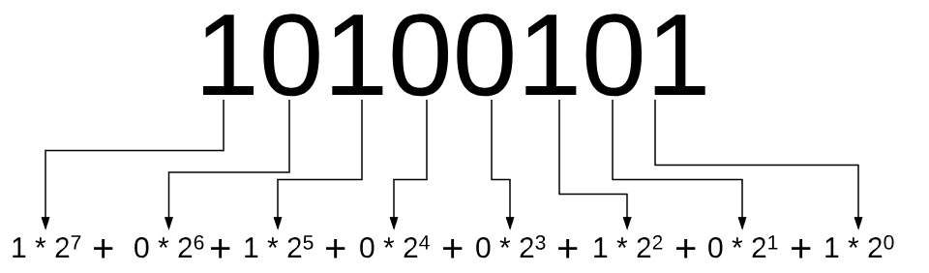
Integers in base 2 (binary)

Slide 12
Operations - Addition
When we add “normal numbers” in base 10, how do we do it?
For each column of digits, starting on the right:
We add (lookup table/memorized) the two digits.
We then divide/modulo that value by the base (10)
The modulo is the “answer”, the quotient is the “carry”
Base 2 is the same, except the base is 2 and the lookup table is short:
0 + 0 = 0 (no carry)
0 + 1 == 1 + 0 = 1 (no carry)
1 + 1 = 0 (carry)

Slide 13
Operations - Subtraction
Works much the same as addition, except that carry (move excess to the left) becomes borrow (move value to the right).

Slide 14
Operations – Multiplication Special Case
When we multiply “normal numbers” by 10, how do we do it?
We add a 0. 1,234 * 10 = 12,340
Divide by 10 is move the decimal place one to the left:
1,234 / 10 = 123.4
Base 2 is the same – to multiply by 2, you shift left.
1010 * 10 = 10100 (2 in base 2 is 10)
1010 / 10 = 101

Slide 15
Operations - Multiplication
When we multiply “normal numbers” in base 10, how do we do it?
For each digit in the second number
Multiply the first number times the digit, carrying like in add
Multiply that result by the base (10) times the order of the digit
Add that result to the sum
Example: 123 X 456 =
123 * 6 + 123 * 5 * 10 + 123 * 4 * 100
Base 2 is the same, except the base is 2

Slide 16
How can we represent negative numbers?
The leftmost (most significant) bit indicates negative when set.
But that gives us a problem – one of the most fundamental identities is that x + -x = 0.
If we have:
0000 0001 (1)
+ 1000 0001 (-1)^{not really}
---------------------------------
1000 0010 This is -2, by a simple “negative if the MSB is set” rule…

Slide 17
Two’s Complement
Instead, we will keep the MSB as the positive/negative indicator, but we will define a negative as the negation of the positive, then add one.
For example, let’s find -7.
0000 0111
Negate 7:
1111 1000
Add 1
1111 1001
0000 0111 (7)
+ 1111 1001 (-7)
0000 0000
0111 1111 (127)
1000 0001 (-127)
0000 0000

Slide 18
One More Thing…
Because we use the left most digit for sign, it is important to “sign extend” when we copy numbers from small spaces to larger ones.
Copy 1010 1010 to a 16 bit register:
1111 1111 1010 1010

Slide 19
Why do we care so much about base 2/binary?
Computers use “on/off” to store values. 2 values = base 2 = binary.
The problem we run into is that our brains aren’t wired nicely for binary. We think in groups of 10, naturally.

Slide 20
Binary Coded Decimal (BCD)
One potential way to solve this dilemma is to use BCD. In BCD, each decimal (base 10) digit is represented as 4 bits. Why 4? 2³ == 8; that’s not enough. 2⁴ = 16, that is enough. In BCD, we get:
Decimal | BCD
0 | 0000
1 | 0001
2 | 0010
3 | 0011
4 | 0100
Decimal | BCD
5 | 0101
6 | 0110
7 | 0111
8 | 1000
9 | 1001
What’s the problem with this system?

Slide 21
Hexadecimal
Instead of wasting ranges and being inefficient, consider a system that uses base 16? In that case, 4 bits give us 16 different digits to work with. We satisfy (sort of) our brains need to work with something less detail oriented than a range of 0’s and 1’s.
The digits are 0-9, then A (10), B(11), C(12), D(13), E(14) and F(15).

Slide 22
Hexadecimal Mapping
Decimal | Hexadecimal | Binary
0 | 0 | 0000
1 | 1 | 0001
2 | 2 | 0010
3 | 3 | 0011
4 | 4 | 0100
5 | 5 | 0101
6 | 6 | 0110
7 | 7 | 0111
Decimal | Hexadecimal | Binary
8 | 8 | 1000
9 | 9 | 1001
10 | A | 1010
11 | B | 1011
12 | C | 1100
13 | D | 1101
14 | E | 1110
15 | F | 1111

Slide 23
Words
It becomes awkward to say “one hexadecimal digit”. Or “two hexadecimal digits”. Or “8 bits”. So we have some terms that are in common use:
nibble: 4 bits (1 hex digit)
byte : 8 bits (2 hex digits)
word : 16 bits (4 hex digits)
longword : 32 bits (8 hex digits)
quadword : 64 bits (16 hex digits)

Slide 24
Logic Operators
Remember from a long time ago AND, OR, NOT, XOR?
AND
0 | 0 | 0
0 | 1 | 0
1 | 0 | 0
1 | 1 | 1
OR
0 | 0 | 0
0 | 1 | 1
1 | 0 | 1
1 | 1 | 1
XOR
0 | 0 | 0
0 | 1 | 1
1 | 0 | 1
1 | 1 | 0
NOT
0 | 1
1 | 0

Slide 25
Shifting & Masking
Assume that you have a longword (32 bits). You need to look at the leftmost 4 bits. How might you do that?
Consider the bits: YYYY XXXX XXXX XXXX XXXX XXXX XXXX XXXX
(in groups of nibbles)
If we only care about Y’s, how can we “get rid of” the X’s?

Slide 26
Shifting
If we right shift the value
YYYY XXXX XXXX XXXX XXXX XXXX XXXX XXXX
28 bits, we will get:
0000 0000 0000 0000 0000 0000 0000 YYYY
But what if our starting value is:
XXXX YYYY XXXX XXXX XXXX XXXX XXXX XXXX

Slide 27
Masking
Starting with this:
XXXX YYYY XXXX XXXX XXXX XXXX XXXX XXXX
We need to remove whatever values are in X, then shift Y’s into the position where we want them.
What operation can we use (AND, OR, XOR, NOT) to do this?

Slide 28
Masking
Starting with this:
XXXX YYYY XXXX XXXX XXXX XXXX XXXX XXXX XXXX
AND
0000 1111 0000 0000 0000 0000 0000 0000 0000
--------------------------------------------
0000 YYYY 0000 0000 0000 0000 0000 0000 0000
Now we can shift the values appropriately (right 28).
This is a mask

Slide 29
Conversion from decimal ←→ hexadecimal
Remember the value of a column. In hex, each column is worth an increasing power of 16: 16⁰, 16¹, 16², and so on as in base 10.
So 0x1234 = 1 X 16³ + 2 X 16² + 3 X 16¹ + 4 X 16⁰
16³ = 4,096, 16² = 256, 16¹ = 16 and 16⁰ = 1
This becomes basic arithmetic at this point.

Slide 30
Decimal to Hexadecimal
If I have the decimal number 1,234, how do I convert that to hexadecimal?
Clearly, there are 0 4,096’s in 1,234. There are 4 256’s.
0x4
Subtract those 4 256’s (1,024) from 1,234 and have 210 remaining.
How many 16’s in 210? 13. 13 in hex is D.
0x4D.
Remove those 208 from 210 and 2 remain.
0x4D2

Slide 31
Hex ←→ Binary
Because base 16 is a multiple of base 2, this is super easy:
From hex → binary, take a single hex digit and look up the bits from the hexadecimal mapping slide.
From binary → hex, make sure that you start on an even 4 bit boundary (left pad with 0’s if necessary), then look up the hex values for each set of 4 bits from the hexadecimal mapping slide.

Slide 32
Floating Point in base 2
IEEE standard 754
A floating point number is represented as scientific notation (remember, 1.234 * 10³)
EXCEPT that scientific notation uses a normalized notation of 1-10 on the left of the decimal and all other digits on the right

Slide 33
IEEE 754
The significant digits are represented as a binary number, as are the exponent.
1.234 ➔ 1234 * 10⁻³ in IEEE754 decimal notation
The number of digits depend on the size of the data type:
16 bits: 11 significant, 5 exponent (between -14 and 15)
32 bits: 24 significant, 8 exponent (between -126 and 127)
64 bits: 53 significant, 11 exponent (between -1022 and 1023)

Slide 34
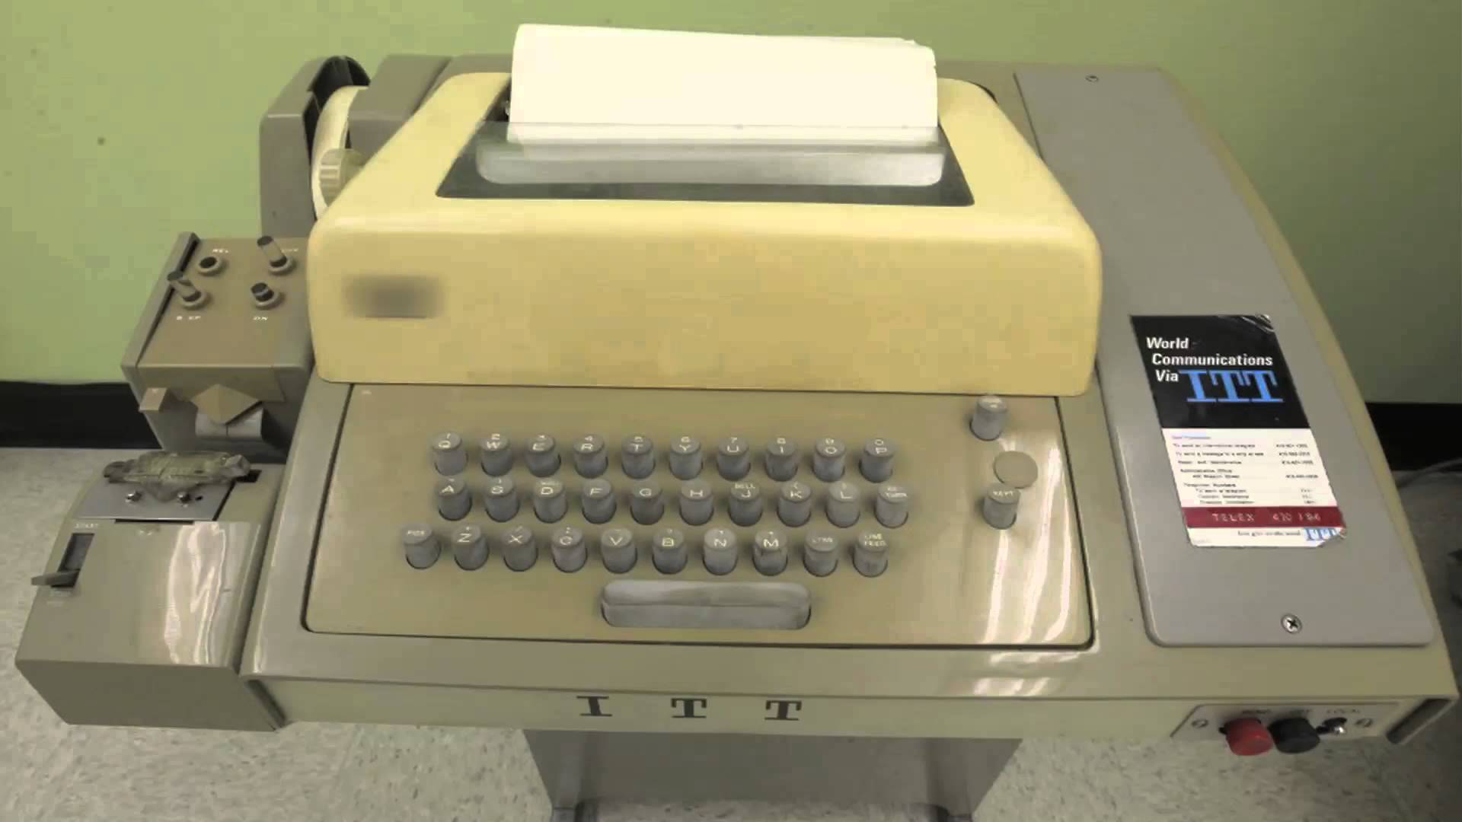
Strings
Strings can be stored in one of many formats.
ASCII was the most common American format:
American Standard Code for Information Interchange
Issues:
Doesn’t support other languages
Designed for teletypes
Benefits:
Simple (all characters are 8 bits)
Small
Ubiquitous

Slide 35
Unicode
As computers became more popular/affordable outside of the US/UK/Australia, it became clear that ASCII wasn’t going to work.
Note – there were other encodings, too, especially in the USSR
Xerox and Apple set out to make a standard that would support every country, language and situation. NeXT, Microsoft and Sun joined later.
The first 256 characters of Unicode are the same as ASCII (to make conversion easy).

Slide 36
Unicode Part 2
Unicode is (basically), like ASCII, a mapping from numbers to letters
It does more, though. There are numerous line terminators beside \r and \n. Multiple space characters, too.
There are hundreds of thousands of characters in Unicode.
How do we represent all of these characters in memory/disk?

Slide 37
Unicode Encoding
The simplest is UTF-32 – a 32 bit fixed width encoding. Every character takes exactly 4 bytes.
4 bytes is a lot. We got by with 1 byte ASCII – can we do something else?
UTF-16 is a 16 bit variable width. If we need to represent a character > 64K, we use a set value for the first 2 bytes indicating that a 32 bit character follows. Windows and OS X use UTF-16.

Slide 38
UTF-16
Windows and Java use UTF-16, a compromise.
7 bit ASCII, as well as many languages (this is called the Basic Multilingual Plane) fit into a single UTF-16 16-bit number.
The byte range D800 – DFFF is reserved for values that don’t fit into 16 bits. For other characters, D800-DBFF is the first 16-bit word (giving 10 bits of the number) and the second word will be DC00-DFFF, giving 10 more bits. This allows for 1,112,064 characters to be referenced.

Slide 39
Unicode Encoding – UTF-8
2 bytes per character? Really? Most of our website is in English. Can’t we just use ASCII? It compresses better and we use less bandwidth…
UTF-8 is the solution for Internet and Unixes.
Represent the first 128 characters (most common ASCII) as 8 bits. Otherwise, the byte tells us what the following bytes are (2 bytes for Unicode 129-65,535, 3 bytes for 65,536-16,777,215, otherwise 4 bytes.
Most space efficient, harder to parse than UTF-32.

Slide 40
How does that work?
If you want to represent a number less than 128, you use one byte.
If you want to represent a number from 128 to 64k, the first byte starts with 110[01] (the first 4 bits; C or D in hex). These 3 bits are the signal that there is another byte coming. The second byte must start with 8,9,A, or B in hex (the first 2 bits are 10). This gives us 11 bits of values – 5 from the first byte, 6 from the second.
For 64k – 16million, the first byte begins with E (hex) and 3 bytes follow.
For > 16 million (including emojis!), the first byte begins with F (hex) and 4 bytes follow.

Slide 41
Some basic physics…
Electricity is the movement of electric charge through a medium.
While not really accurate, I like the mental image of a tube full of ping pong balls. As you push balls in, they move through the tube.
The medium has resistance (think of it as the balls rubbing against the inside of the tube). Resistance causes heat.
We measure the voltage as the difference in potential – you can imagine it as the speed of the ping pong balls.

Slide 42
Resistance and Heat
The faster you push the ping pong balls (the greater the voltage), the more the friction (Ohmic heating) is generated.
This is a square relationship, unfortunately…
The biggest single limitation in computers today is heat generated by Ohmic heating…

Slide 43
Why do we use base two?
There were attempts at a computer that used varying voltages to indicate values. Think about a computer that used 1 volt for 1, 2 volts for 2.
What’s the problem with this?

Slide 44
Why do we use base two?
There were attempts at a computer that used varying voltages to indicate values. Think about a computer that used 1 volt for 1, 2 volts for 2.
What’s the problem with this?
Resistance! Over time the voltage is reduced by resistance.
So, instead, we use a threshold – anything over (say) .5 volts is “on” or 1

Slide 45
How do we turn all of this into a computer?
It went in iterations…

Slide 46
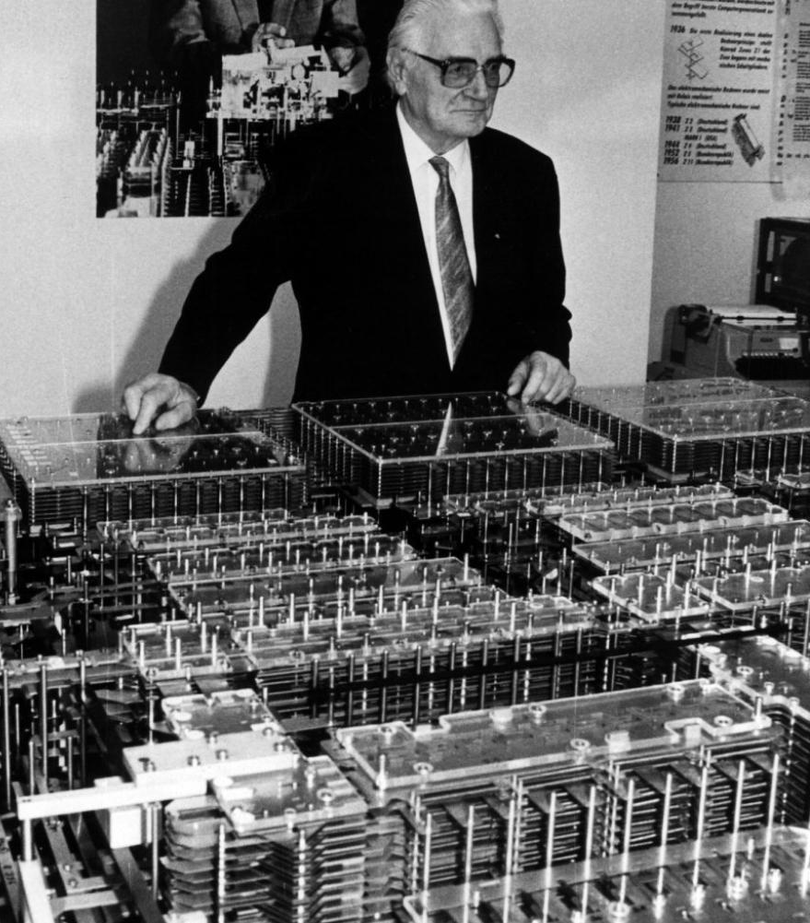
Konrad Zuse
A Civil Engineer in 1930’s Germany, he needed to solve huge systems of linear equations. Doing it by hand was too slow, so he started to invent a machine to do the work.

Slide 47
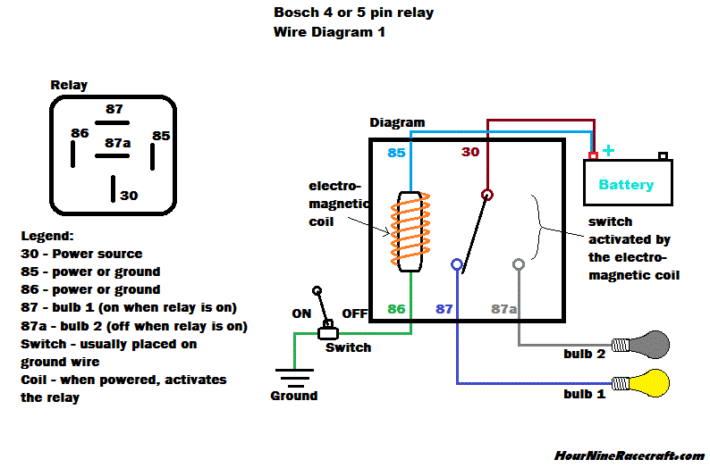
Relays

Slide 48
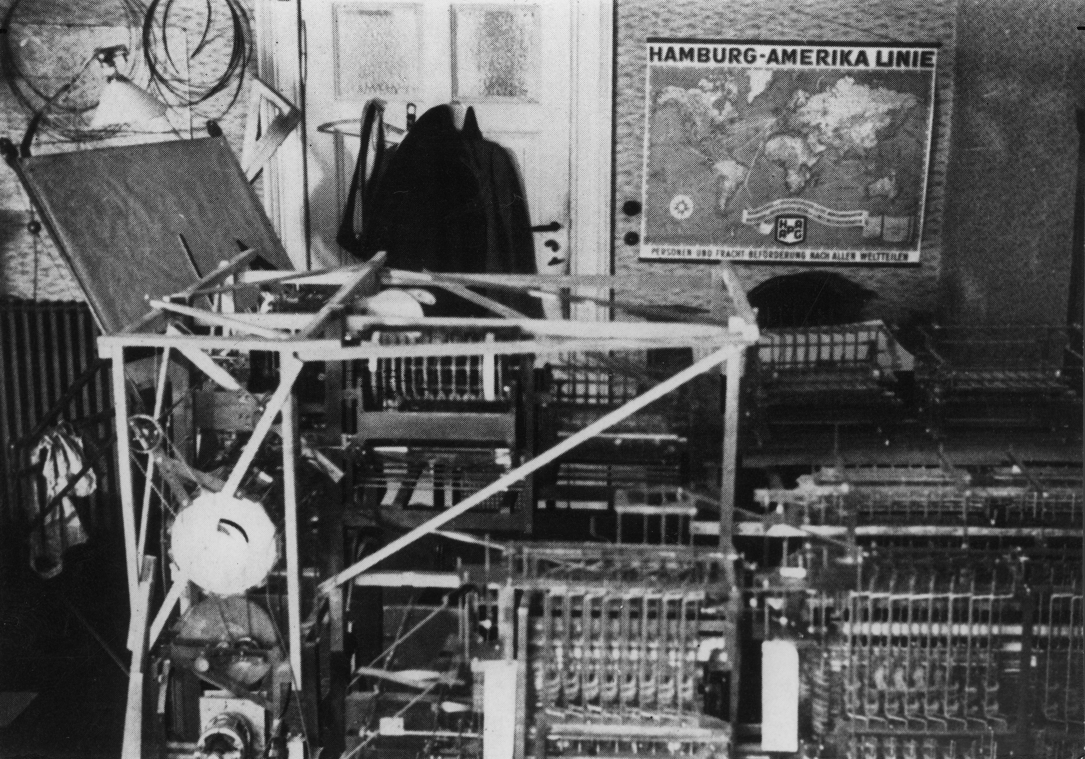

Slide 49
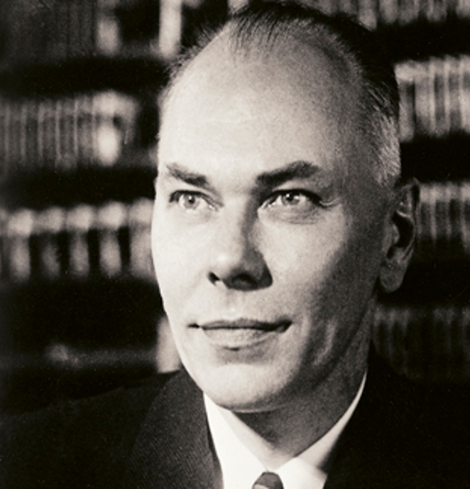
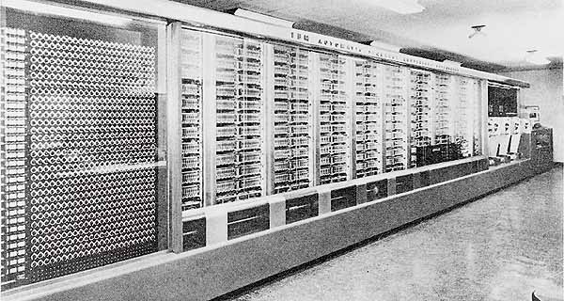
At the same time…
Howard Aiken, a physicist at Harvard, needed to solve differential equations quickly for his thesis. So he invented a machine to do so – the Mark I. IBM helped fund it and it was built in Endicott, NY! It was later moved to Harvard.

Slide 50
Both men were interrupted by World War 2
Of course, during this time, Colossus was created by Alan Turing. If you haven’t seen The Imitation Game, it is a decent movie about Turing’s life.
After World War 2, the pace picked up!

Slide 51
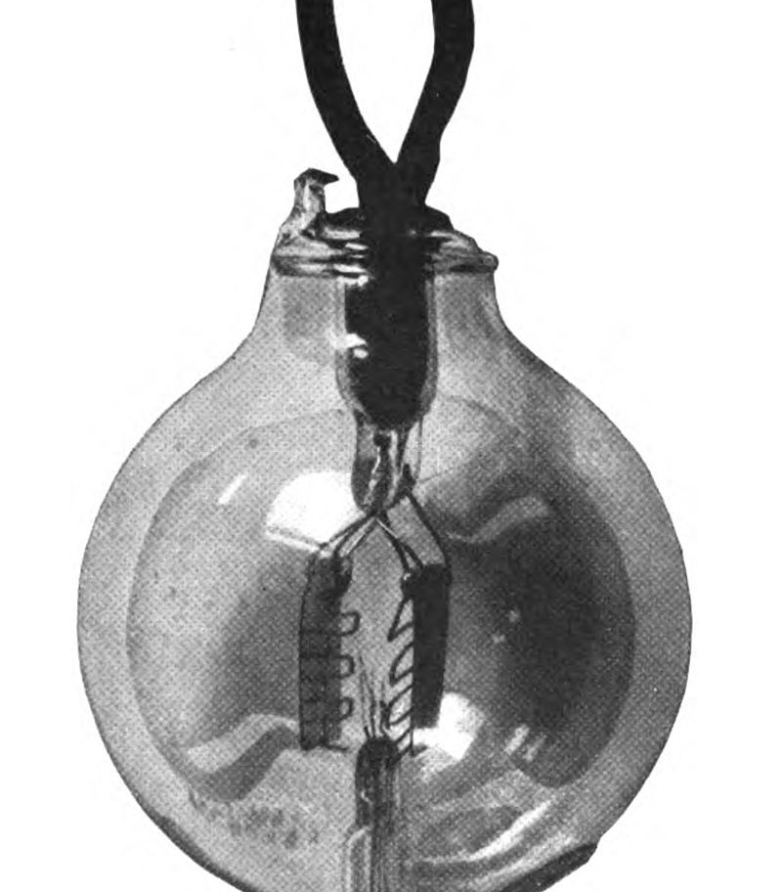
Vacuum Tubes
Simple switches which used the thermionic effect (heated metal radiating ions) to create a switch. Because these were not mechanical (had no moving parts) they were faster and failed less frequently than relays. The famous ENIAC used them. They still failed, though, and the search for a better solution was ongoing…

Slide 52
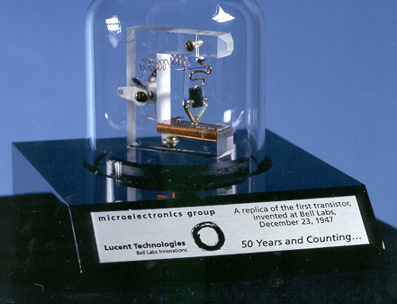
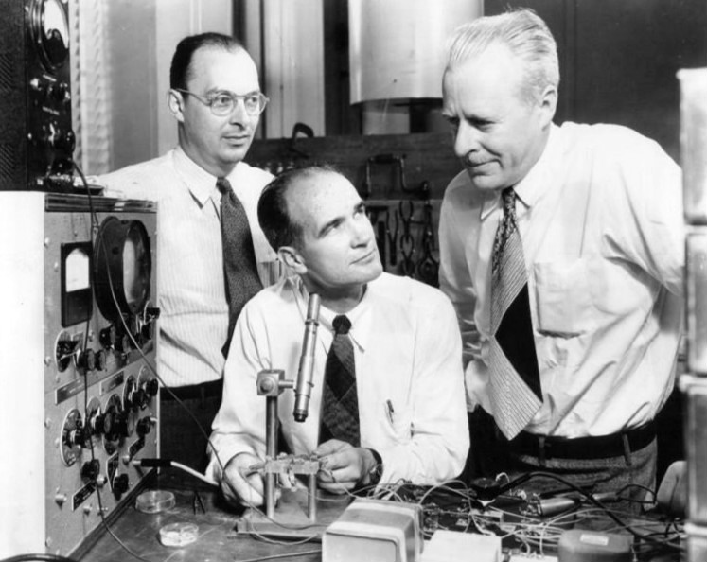
The Transistor!
Tubes switched slowly and had to warm up before they worked.
Developed at Bell Labs, but others were working on it at the same time (Late 1947/Early 1948)
Improvements in transistors continued through the 1950’s and 1960’s; IBM built the 7070 (1958) and 7090 (1960) computers with transistors.

Slide 53
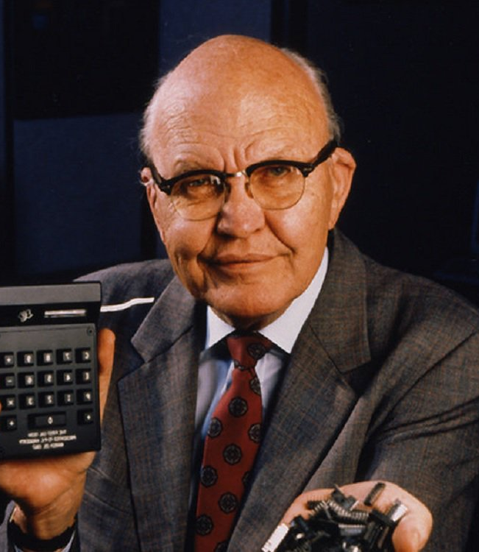
Integrated Circuits
A transistor is tiny, compared to a tube, but is still too big and requires a lot of work to assemble into a useful device. The IC integrates transistors into a single, integrated package. It was invented by Jack Kilby at Texas Instruments although many others were trying at the same time.

Slide 54
The First Processor
While there were a few other chips that were contemporaneous, the first commercially available processor was the Intel 4004. It ran at 740 khz, was comprised of 2,300 transistors and had 12 address pins (640 bytes of addressable RAM and 4,096 bytes of ROM).
It was followed by the 8008, then the 8080, then the 8086, then the 80286, 80386, 80486, Pentium, etc…

Slide 55
Enough history… More review…
If we have a Boolean function that takes two parameters: z = f(x,y)
How many different functions are possible in this form?

Slide 56
X | Y | F0 | F1 | F2 | F3 | F4 | F5 | F6 | F7
0 | 0 | 0 | 0 | 0 | 0 | 0 | 0 | 0 | 0
0 | 1 | 0 | 0 | 0 | 0 | 1 | 1 | 1 | 1
1 | 0 | 0 | 0 | 1 | 1 | 0 | 0 | 1 | 1
1 | 1 | 0 | 1 | 0 | 1 | 0 | 1 | 0 | 1
X | Y | F8 | F9 | F10 | F11 | F12 | F13 | F14 | F15
0 | 0 | 1 | 1 | 1 | 1 | 1 | 1 | 1 | 1
0 | 1 | 0 | 0 | 0 | 0 | 1 | 1 | 1 | 1
1 | 0 | 0 | 0 | 1 | 1 | 0 | 0 | 1 | 1
1 | 1 | 0 | 1 | 0 | 1 | 0 | 1 | 0 | 1
You might notice some old friends in there –
F1 is AND F14 is NAND
F7 is OR F8 is NOR
F12 is NOT (X) F10 is NOT (Y)
F6 is XOR F9 is XNOR

Slide 57
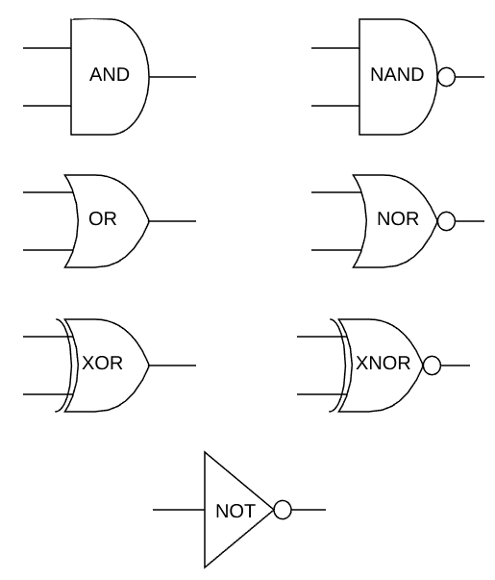
Circuit Diagrams

Slide 58
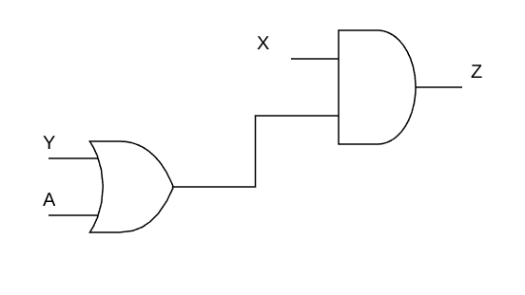
Different Representations of the same thing
z = x & (y | a);

Slide 59
Adding Two Numbers
Let’s think about a truth table for adding two binary numbers:
This should look a lot like one of the functions from
our previous slide.
X | Y | Add
0 | 0 | 0
0 | 1 | 1
1 | 0 | 1
1 | 1 | 0*

Slide 60
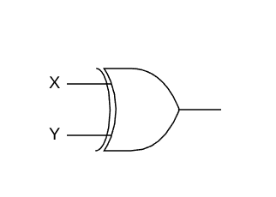
A 1 bit adder is just an XOR

Slide 61
Let’s make it a 2 bit adder.
First, the truth table:
X1 | X2 | Y1 | Y2 | A1 | A2
0 | 0 | 0 | 0 | 0 | 0
0 | 0 | 0 | 1 | 0 | 1
0 | 0 | 1 | 0 | 1 | 0
0 | 0 | 1 | 1 | 1 | 1
0 | 1 | 0 | 0 | 0 | 1
0 | 1 | 0 | 1 | 1 | 0
0 | 1 | 1 | 0 | 1 | 1
0 | 1 | 1 | 1 | 0 | 0
X1 | X2 | Y1 | Y2 | A1 | A2
1 | 0 | 0 | 0 | 1 | 0
1 | 0 | 0 | 1 | 1 | 1
1 | 0 | 1 | 0 | 0 | 0
1 | 0 | 1 | 1 | 0 | 1
1 | 1 | 0 | 0 | 1 | 1
1 | 1 | 0 | 1 | 0 | 0
1 | 1 | 1 | 0 | 0 | 1
1 | 1 | 1 | 1 | 1 | 0

Slide 62
That’s a little … much
A2 is still X2 XOR Y2. That’s not so bad.
But A1 is not just X1 XOR Y1. Because of carry. Just like when you add 9+5 and get 14 – that 1 is a carry.
A1 = X1 XOR Y1 XOR (X2 AND Y2)
Imagine doing this with 32 bit addition… Or 64…

Slide 63
An easier way!
Let’s consider a different approach.
What if we had a circuit of some sort that took carry into account. It had a carry input and a carry output.
Functionally, something like this:
s,c_{o} = add(x,y,c_{i})
(s = sum, c is carry in/out, x and y are inputs)

Slide 64
What would that truth table look like?
X | Y | C_{in} | S | C_{out}
0 | 0 | 0 | 0 | 0
0 | 0 | 1 | 1 | 0
0 | 1 | 0 | 1 | 0
0 | 1 | 1 | 0 | 1
1 | 0 | 0 | 1 | 0
1 | 0 | 1 | 0 | 1
1 | 1 | 0 | 0 | 1
1 | 1 | 1 | 1 | 1

Slide 65
Can we build that?
YES!
S = X XOR Y XOR C_{in}
C_{out} = X AND Y OR (( X XOR Y) AND C_{in})

Slide 66
